Slide 1

Covid-19 – A Study

Slide 2

Introduction
Covid-19 is a virus (more specifically, a coronavirus) identified as the cause of an outbreak of respiratory illness first detected in Wuhan, China.
Individual risk for the disease is dependent on exposure.
Detected in almost 150 locations internationally
Close to 1,70,000 people sickened by COVID-19 and more than 7,000 people have died from the disease.
WHO has declared COVID-19 a pandemic
2

Slide 3
Methodology
Collect covid-19 related data from https://github.com/CSSEGISandData/COVID-19 and https://www.kaggle.com/sudalairajkumar/novel-corona-virus-2019-dataset
Explore, understand the data, data pre-processing
Using Foursquare API we will find all location related information
Visualize and Analyse using folium library(python) and plotly
Let’s get started !

Slide 4
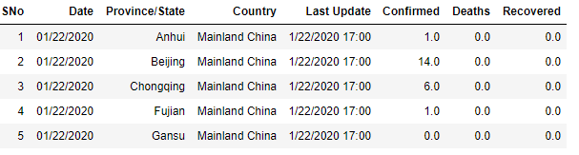
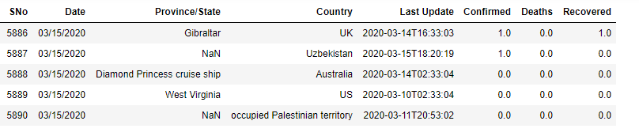
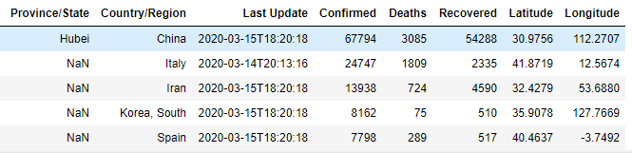
What does our data look like ?
Dataset 1
Dataset 2

Slide 5
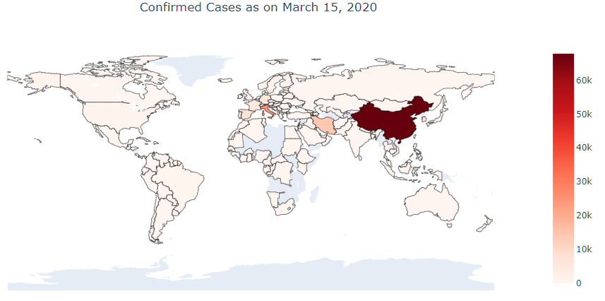
The highest number of confirmed cases (as on March 15, 2020), has been recorded in China, followed by Italy and then Iran. US, Brazil, Australia and other countries also have a considerable number of confirmed cases.

Slide 6
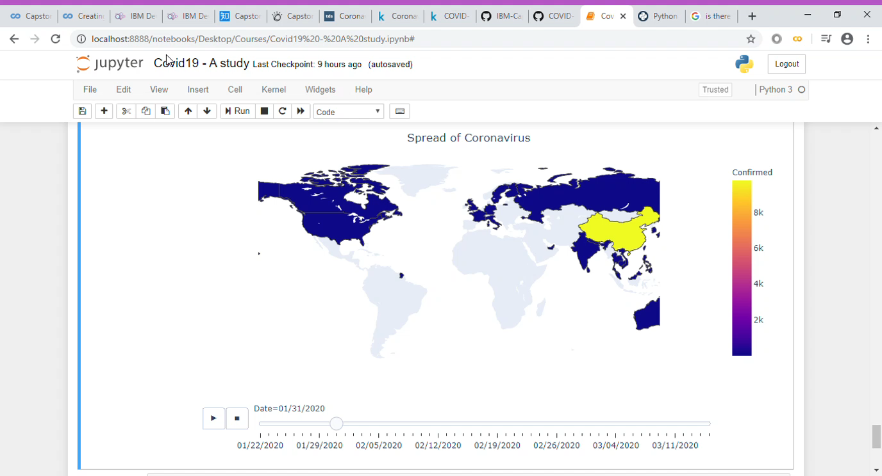
This is an animated choropleth which shows how coronavirus has been spreading, starting from 22nd January to 15th March, 2020.

Slide 7
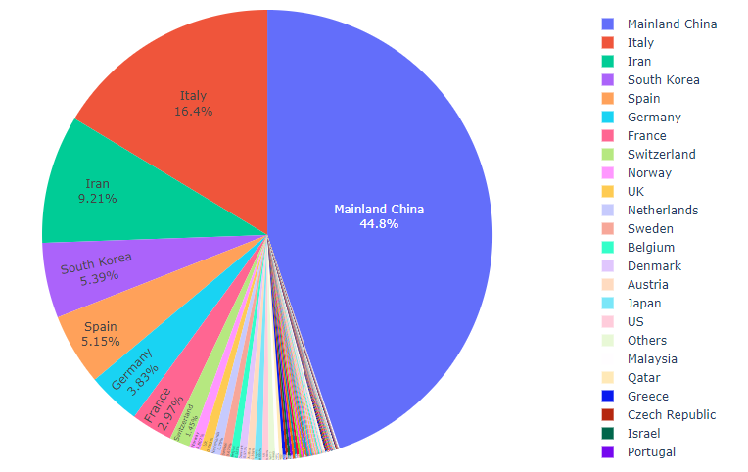
It’s clear that the majority of confirmed cases remain in China. However, there has been a gargantuan increase in number of cases outside China, sum of which is more than that in China

Slide 8
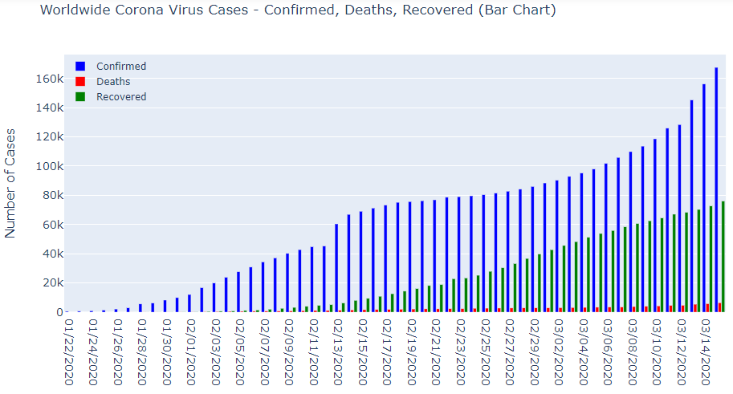
The bar chart shows confirmed, deaths, and recovered cases worldwide. We can see a spike in the number of confirmed cases on 13th February due to a new method of reclassifying confirmed cases. Increasing number of countries with cases towards the end of February

Slide 9
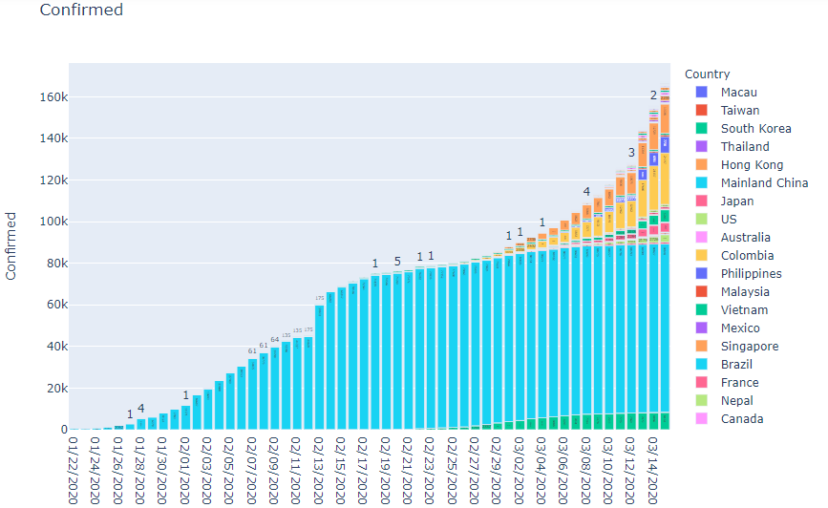
In case of Mainland China, the curve has flattened in late February and March, to a great extent. The increase is no longer exponential, which is a positive sign and also shows China's competency in dealing with this pandemic. On the other hand, there has been an exponential increase in confirmed cases outside China, especially in Italy.

Slide 10
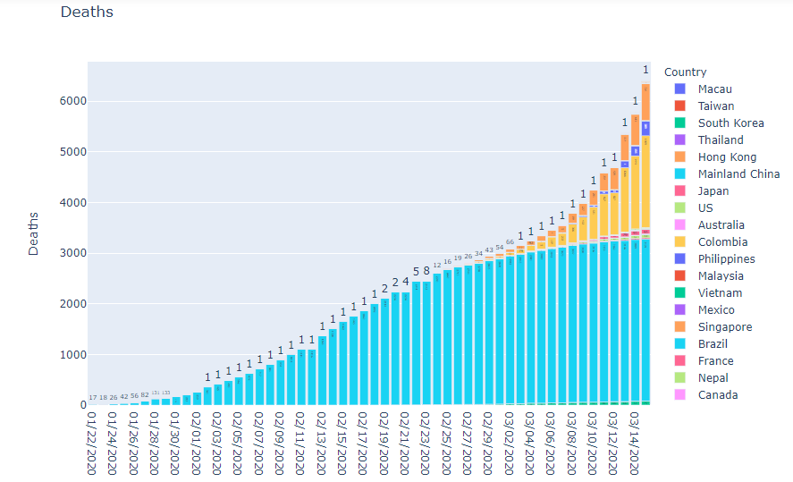
Similarly, death cases have also seen a gradual increase. The curve has flattened in China but is still exponential outside China,especially in Italy and Iran.

Slide 11
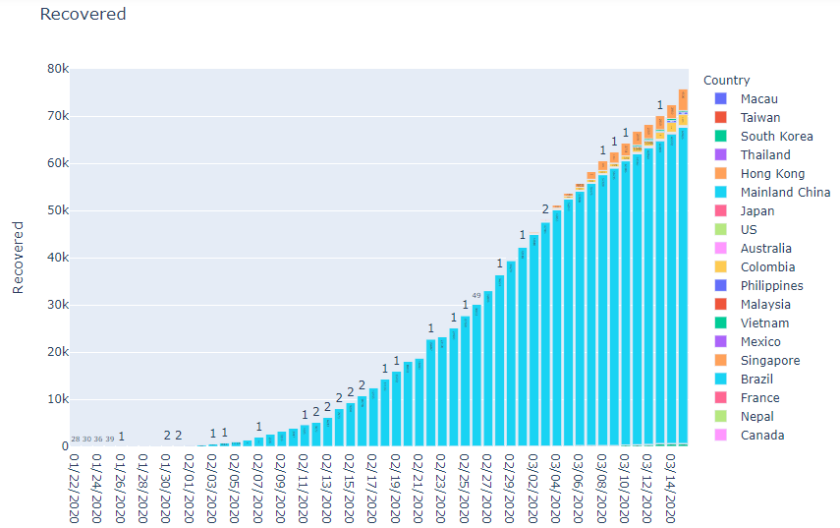
The bar chart is an indicator of the exponential increase in the number of recovered cases. The aim is to not let this graph flatten with time, till all the cases have recovered.

Slide 12
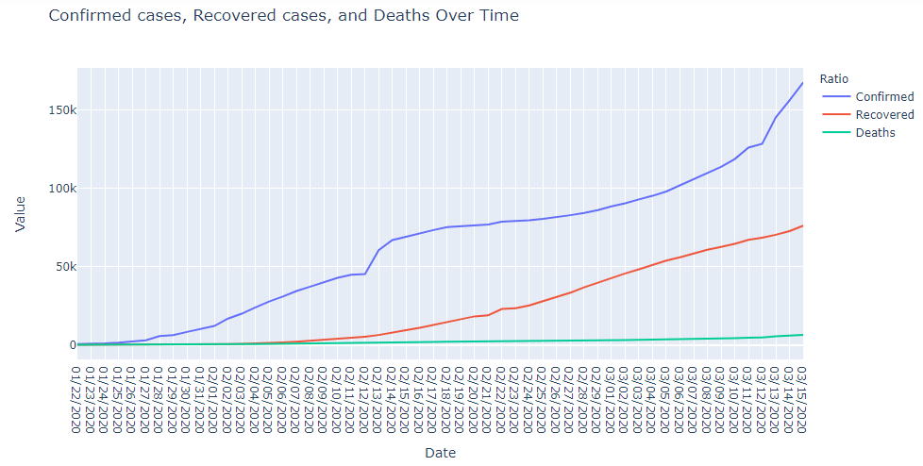
This is a consolidated representation of the bar graphs shown above. Ideally, we would like to see the red line and blue line converge and pass each other

Slide 13
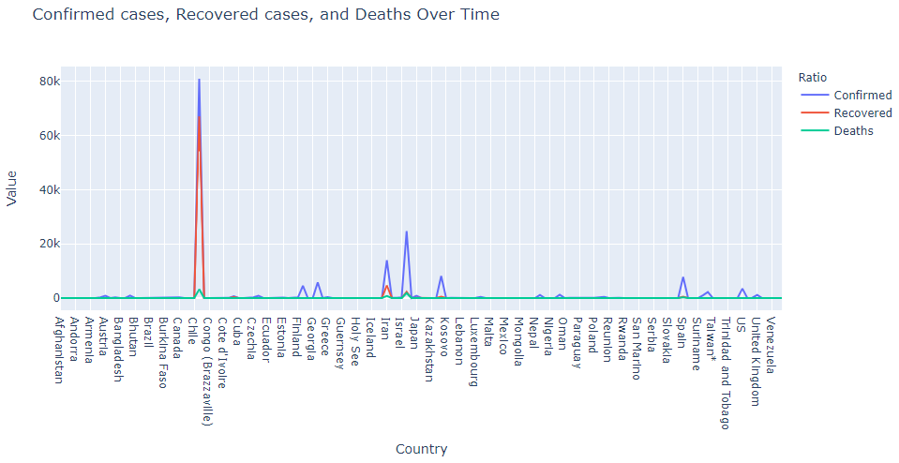
The line chart shows the number of confirmed, recovered and death cases across the globe, as on 15th March,2020. The mortality rate is around 4% in China whereas it is around 2.5% in Iran.

Slide 14
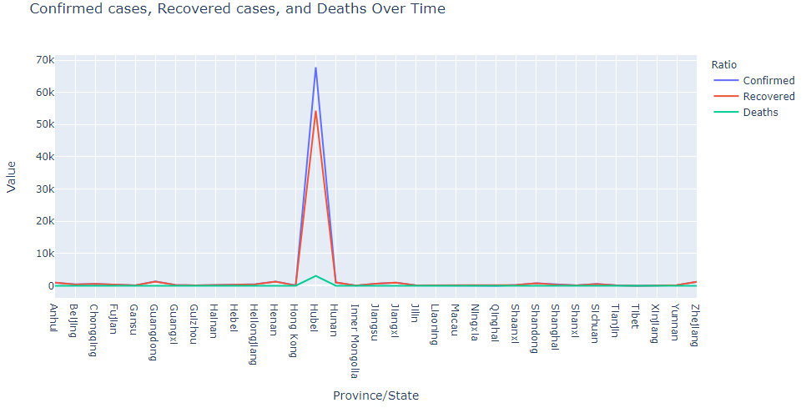
As we know, Wuhan, capital of Hubei has been the epicenter of the disease with almost 67,794 confirmed cases as on 15th March, with around 80% cases of recovery.

Slide 15
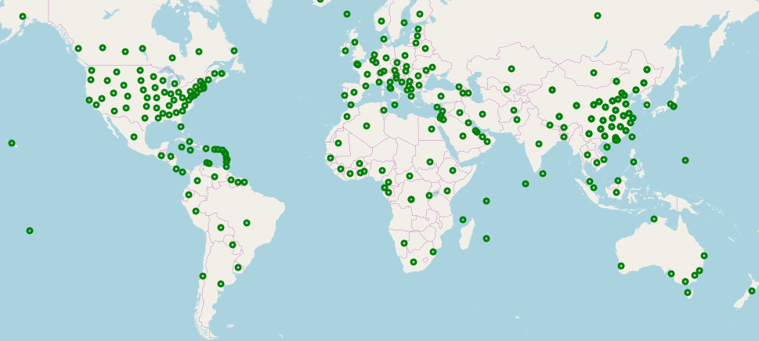
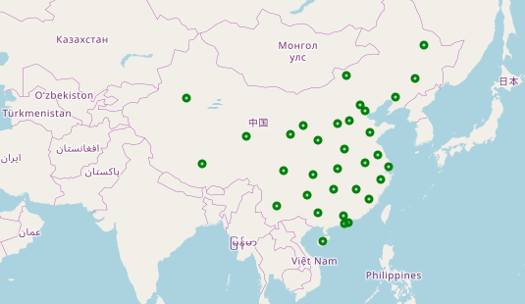
The maps show the areas affected worldwide and then focusing on China, respectively. We have a list of all the provinces in China where people have been affected by Covid-19.

Slide 16
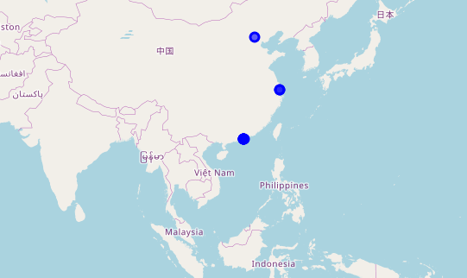
Using Foursquare API, we searched for hospitals within 5 km of these areas, so as to see the distribution of hospitals in these provinces. This distribution plays an important role in determining accessibility to healthcare facilities in case of a health disaster like this.

Slide 17

Conclusion
With no vaccine or treatment that can prevent it yet, containing the spread of Covid-19 is vital. As a final note, all of the above analysis is dependent on the adequacy and accuracy of the data collected from various sources and Foursquare API. A more comprehensive analysis and future work would need incorporation of data from other external databases.

Slide 18
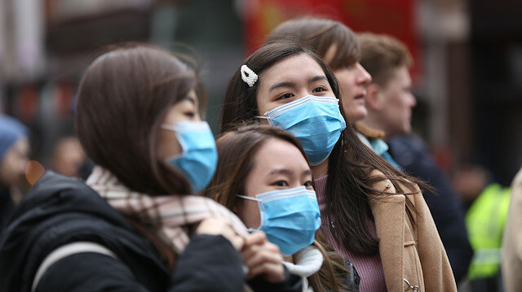
THANK YOU Stay Safe !
Insert Image

